Slide 1
EVS Sem 2 unit 4 Environment Movements

Slide 4
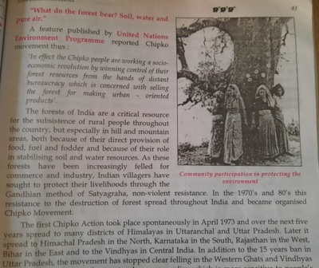

Slide 6
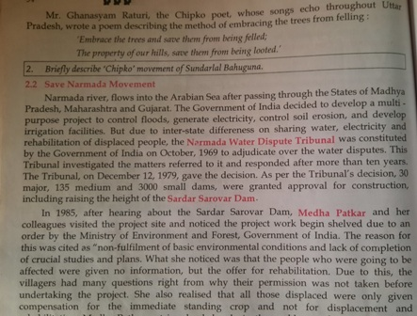

Slide 15
Environment Management

Slide 21
Scope of EIA
Stage 1- Defining present environment with respect to parameters, such as land use, water use, soil, hydrology.
Stage 2- Study components of project which would have an effect on various aspects of the environment.
Stage 3- Measurement of quantum and character of the pollutants discharged.
Stage 4- Assessment of the impact of such pollutants.
Stage 5- Recommendation of measures

Slide 22
Methodologies
Landuse
Water use
Geology
Soils
Hydrology
Water quality
Meteorology
Surrounding air quality
Suspended particulate matter
Terrestrial ecology
Aquatic ecology
Noise
Demography

Slide 45
Environment Protection Acts

